Slide 1
Taxonomy
For Grouping and Naming Organisms

Slide 2
What’s a taxonomist?
A taxonomist studies & researches…
The way organisms are
GROUPED and NAMED

Slide 3
Taxonomic rankings
…the main classification and source for naming organisms

Slide 4
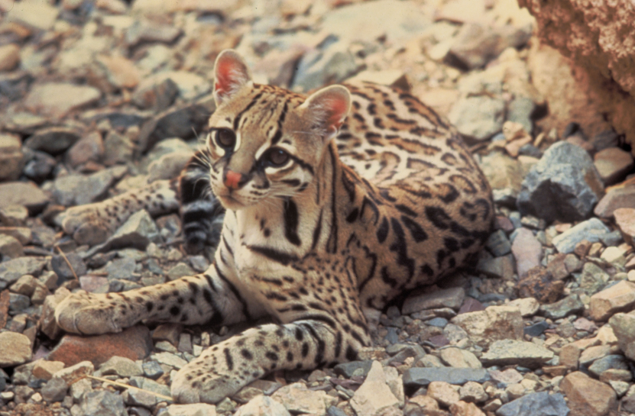
TAXONOMIC RANKS: EXPLAINED
Organisms are grouped from taxa which start
Broad and grow more specific
Organisms’ taxonomic names come from their
Genus and species
Ex. Leopardus Pardalis

Slide 5
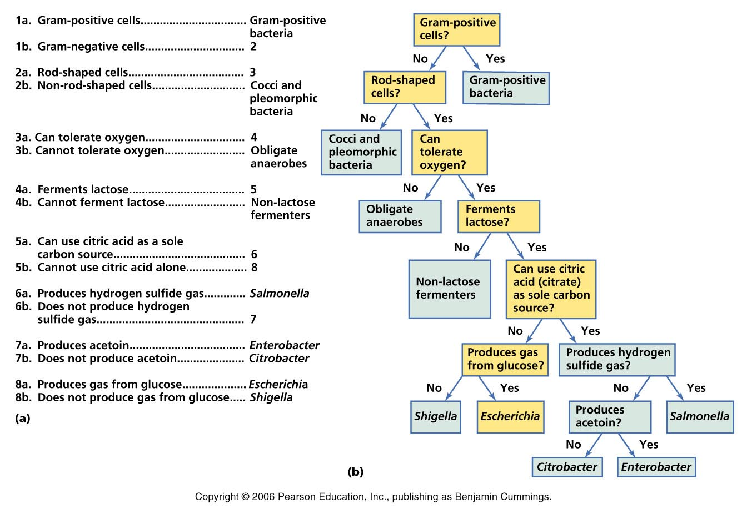
Dichotomous keys
To find out an organism’s name, you use this…

Slide 6
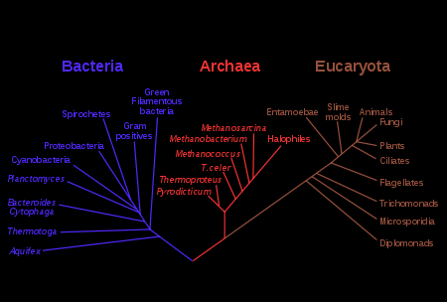
Phylogenetic trees
Organisms are also classified by similarities…

