Slide 1
Protein Synthesis PowerPoint
Kaytie Sherman
Patrick Golden
Kiante Graham

Slide 2
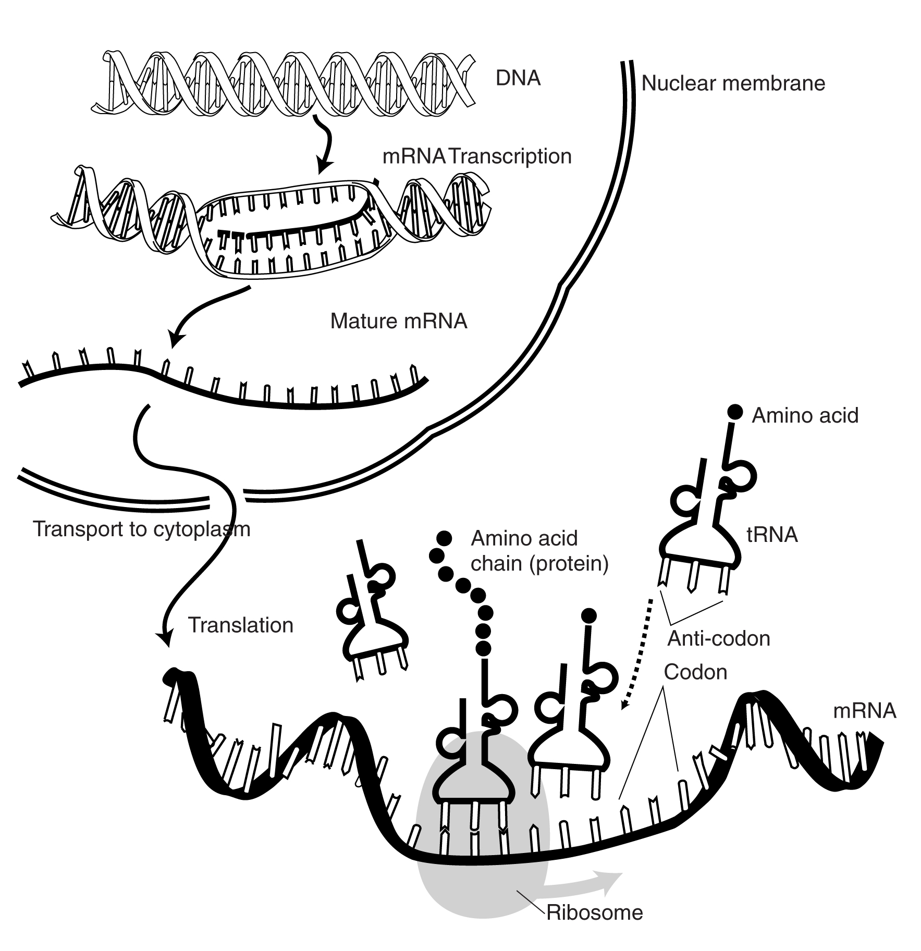
Protein Synthesis

Slide 3
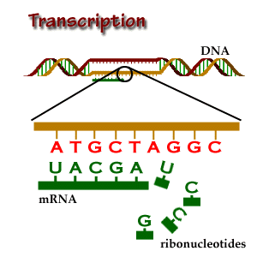
Transcription
It is the process of making a copy of genetic information stored in the DNA strand into a complimentary strand of RNA (mRNA) with the aid of RNA polymerases.

Slide 4
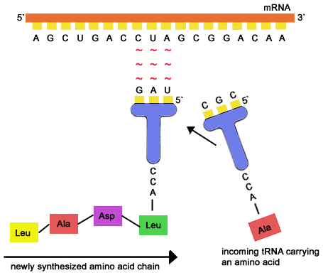
Translation
A step in protein synthesis wherein the genetic code carried by mRNA is decoded to produce the specific sequence of amino acids in a polypeptide chain.

Slide 5
mRNA, tRNA, & rRNA
mRNA - is the type of RNA that codes for the chemical blueprint for a protein, during protein synthesis
tRNA - RNA involved in protein synthesis, transporting specific amino acid to be added onto the growing polypeptide chain.
rRNA – rRNA sits in the Ribosome, decoding the mRNA into various amino acids and assisting translation.

Slide 6
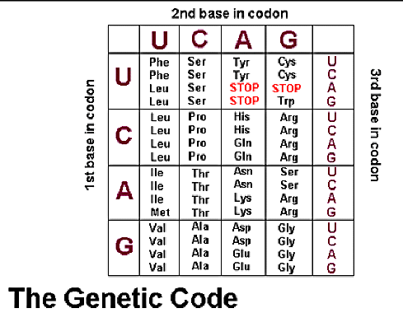
Codons
A set of hree adjacent nucleotides in mRNA that base-pair with the corresponding anticodon of tRNA molecule that carries a particular amino acid, specifyng the type and sequence of amino acids for protein synthesis.

