Slide 1
Photosynthesis and Respiration
By Jacob Murphy
And
Gerardo Cisneros

Slide 2
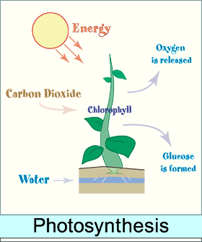
Photosynthesis
the complex process by which carbon dioxide, water, and certain inorganic salts are converted into carbohydrates by green plants, algae, and certain bacteria, using energy from the sun and chlorophyll.

Slide 3
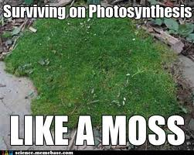
How it photosynthesis works
Use by green plants of the energy in sunlight to carry out chemical reactions, such as the conversion of carbon dioxide into oxygen. Photosynthesis also produces the sugars that feed the plant.

Slide 4
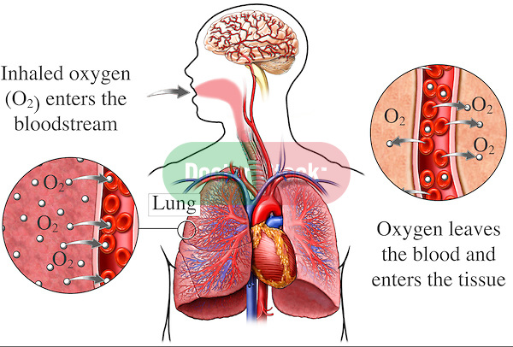
Respiration
The process by which organisms exchange gases, especially oxygen and carbon dioxide, with the environment. In air-breathing vertebrates, respiration takes place in the lungs. In fish and many invertebrates, respiration takes place through the gills. Respiration in green plants occurs during photosynthesis.

Slide 5
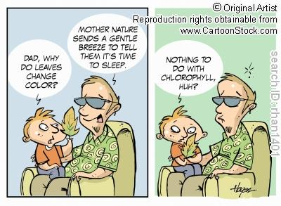
How Respiration works
Cellular respiration is breaking down the glucose molecule into usable energy (ATP) for the cell. The first step in cellular respiration is breaking down the glucose molecule through glycolysis into pyruvic acid. Here there is two ATP that are produced. Then there is anaerobic respiration ( if oxygen isn't present) which includes alcohol fermentation/ lactic acid fermentation. If oxygen is present then aerobic respiration takes place. The two main steps in aerobic respiration is Krebs Cycle ( 2 ATP produced) and Electron Transport Chain. ( up to 36 ATP produced)

