Slide 1
Mitosis & Meiosis
Kassie Spurgis
Dazman Salgado

Slide 2
What is Mitosis?
It is a type of cell division that results in two daughter cells, they are each the same as their parent nucleus.
It’s a sexual reproduction

Slide 3
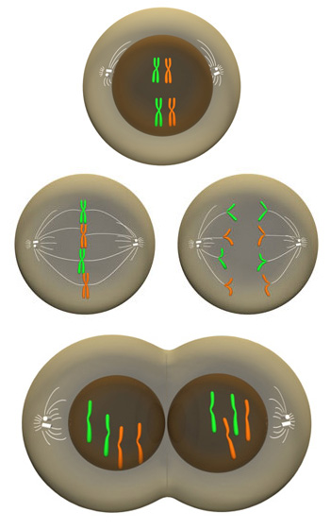
Stages of Mitosis
Stage 1: Interphase
Stage 2: Prophase
Stage 3: Metaphase
Stage 4: Anaphase
Stage 5: Telophase
Stage 6: Cytokinasis

Slide 4
What is Meiosis?
Is a cell division that results in Four daughter cells each with ½ the chromosome number of the parent cell.
It makes eggs or sperm, which makes sexual reproduction possible.
Creates genetic variation.

Slide 5
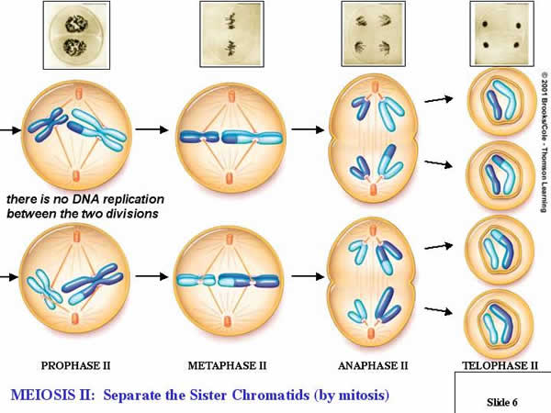
Stages of Meiosis
Stage 1: Interphase
Stage 2: Prophase I
Stage 3: Metaphase I
Stage 4: Anaphase I
Stage 5: Telophase I
Stage 6: Prophase II
Stage 7: Metaphase II
Stage 8: Anaphase II
Stage 9: Telophase II

Slide 6
http://www.cellsalive.com/mitosis.htm
http://highered.mcgraw-hill.com/olcweb/cgi/pluginpop.cgi?it=swf::535::535::/sites/dl/free/0072437316/120074/bio19.swf::Stages%20of%20Meiosis

