Slide 1
Membrane Transport
By: Michaela and Daniel

Slide 2
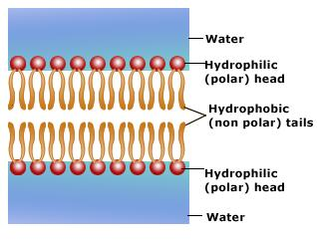
Membrane Transport
Membrane Transport is the selective membrane permeability.
The membrane is made up of lipid bilayers that contain proteins inside them.
This is the passage of solutes that ions and small molecules through.
Inside the lipid bilayers are hydrophilc heads that are polar and hydrophobic tails that are nonpolar.

Slide 3
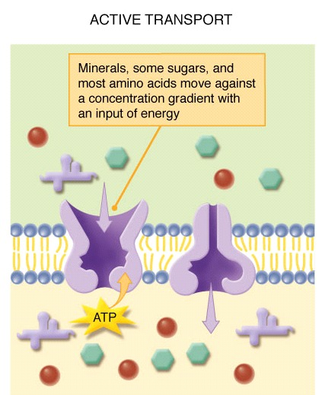
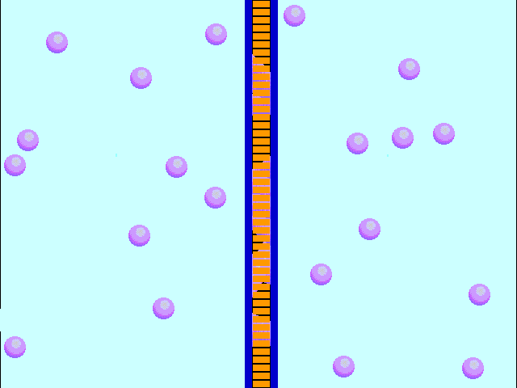
Transports
Movement of a substance from low to high concentration.
This uses chemical energy like ATP.
Movement of biochemicals or other atomic substances across the membrane. Uses high to low concentraiton.
No energy required.
Active Transport
Passive Transport

Slide 4
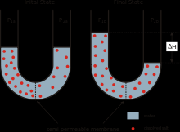
osmosis
Diffusion of water molecules across the semi-permeable membrane.
From high to low concentration.
Part of passive transport.

Slide 5
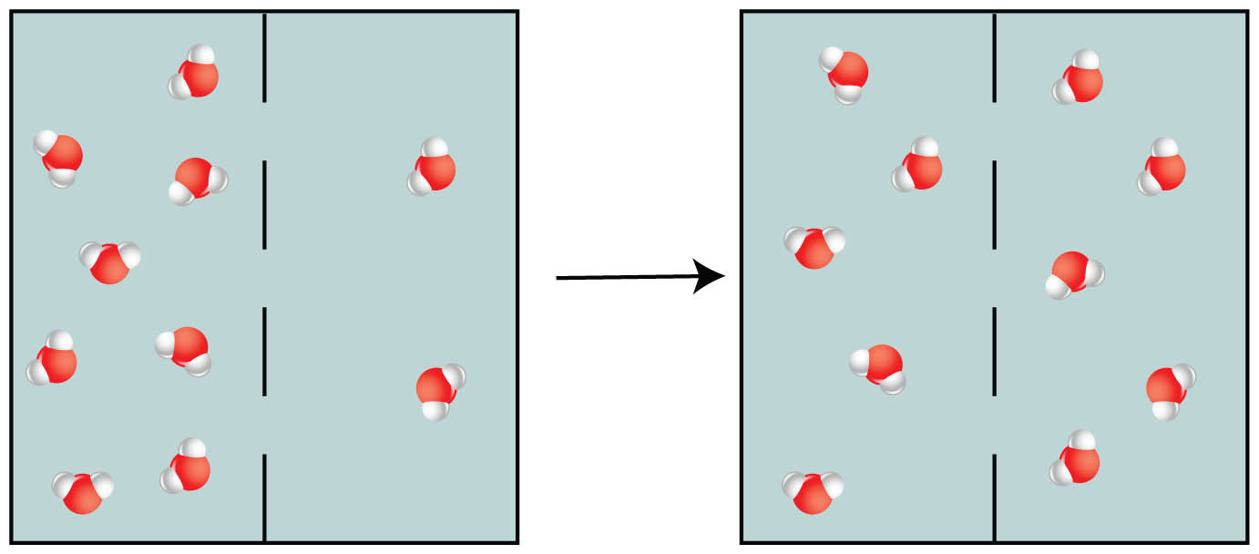
Diffusion
Movement from a high concentraion to a low concentration.
Described as moving down the concentration gradient.
Part of passive transport.

