Slide 1
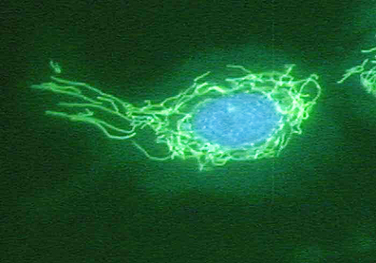
GENETICS
BY “DEREK” SETH AND TOMMY!!
WOOOOOOOO!!!!!!

Slide 2
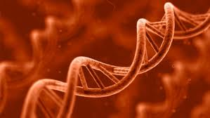
What is a gene?
A short piece of DNA that codes for a protein to make a trait.

Slide 3
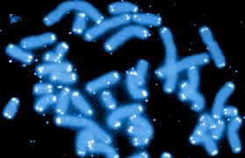
How do genetics work
Genes, through the proteins they encode, determine all body processes, including how the body responds to challenges from the environment.

Slide 4
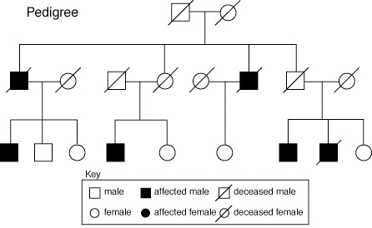
Pedigree Chart
Pedigree charts are a way for genealogists to record their research and arrange it in an organized fashion.

Slide 5
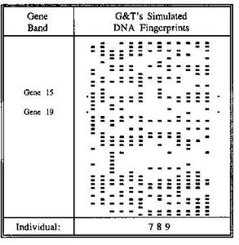
DNA Fingerprint Chart
Helps you identify people by there DNA fingerprint.

Slide 6
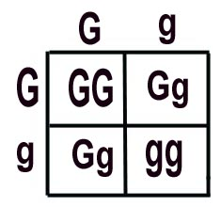
Punnet Square
The Punnet square is a diagram that is used to predict an outcome of a particular cross or breeding experiment

Slide 7
http://www.monkeysee.com/play/24745-what-is-genetics

