Slide 1
Evolution

Slide 2
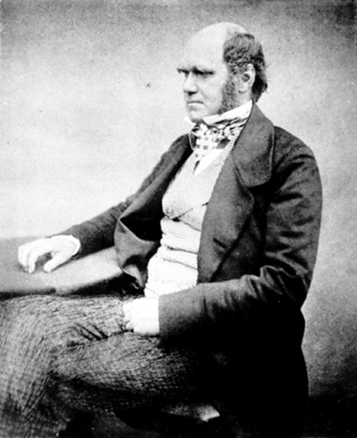
Theory of Evolution
Evolution is the change in the inherited characteristics of biological populations over successive generation
Charles Darwin suggested that all living things come from a common ancestor

Slide 3
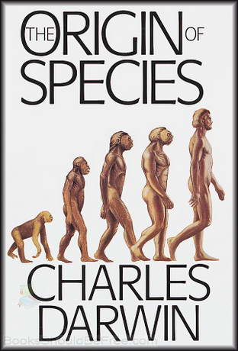
Charles Darwin
Charles Darwin was an English naturalist
Sailed around South America to study the Galapagos Islands
Wrote a book entitled On the Origin of Species

Slide 4
Natural Selection
Natural selection is the process by which biological traits are passed on to the next generation
“Survival of the fittest” means the organism best suited for its environment is more likely to survive

Slide 5
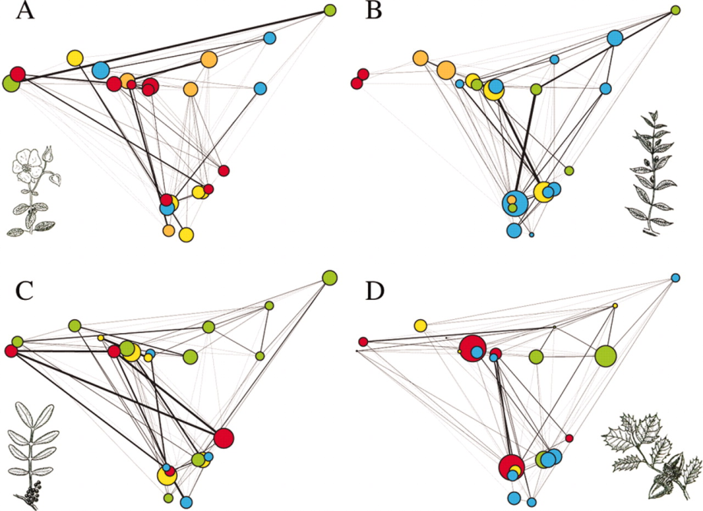
Genetic Variation
Natural selection will only occur is there is genetic variation in an environment
Over time animals have changed to suit their environment

