Slide 1
Ecology
Created by : Tnasty and
Tnasty

Slide 2
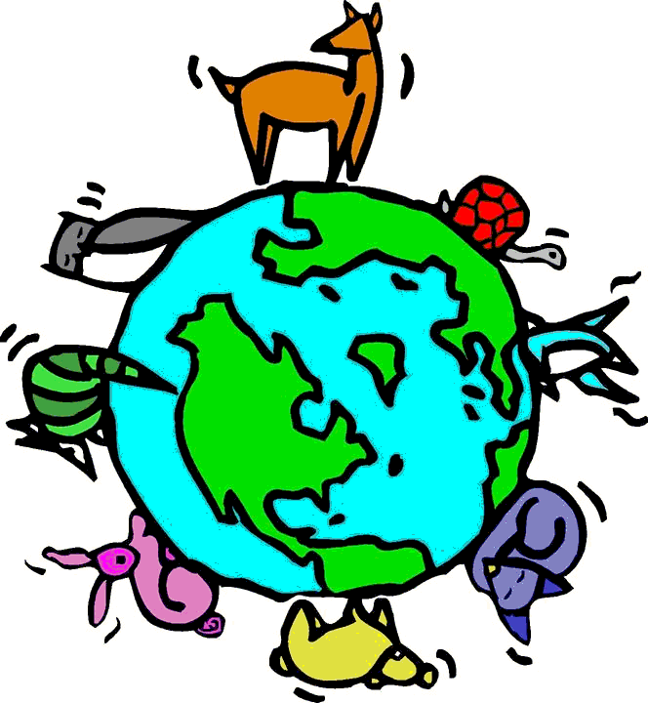
Definition
Ecology - is the scientific study of the relationships that living organisms have with each other and with their natural environment.
Follow @derekrd24 and @tmanuel01 on twitter

Slide 3
Ecology Video
http://www.brightstorm.com/science/biology/ecology/ecology-overview/
Follow @derekrd24 and @tmanuel01 on twitter

Slide 4
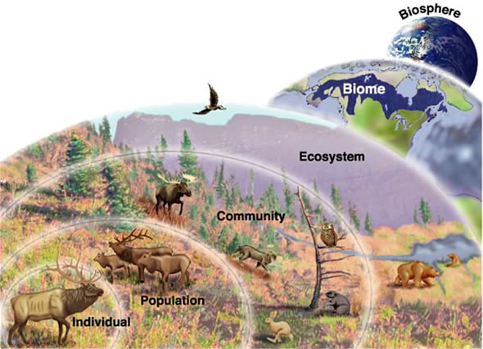
Ecology levels
Follow @derekrd24 and @tmanuel01 on twitter

Slide 5
Works cited
http://www.brightstorm.com/science/biology/ecology/ecology-overview/
http://en.wikipedia.org/wiki/Ecology

